Slide 1
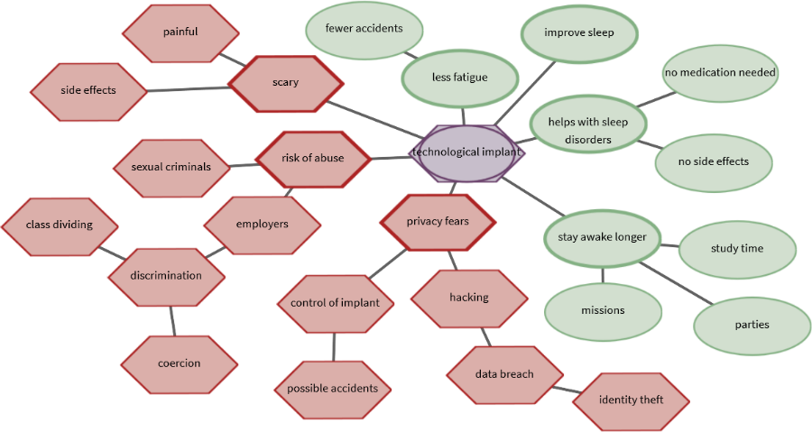
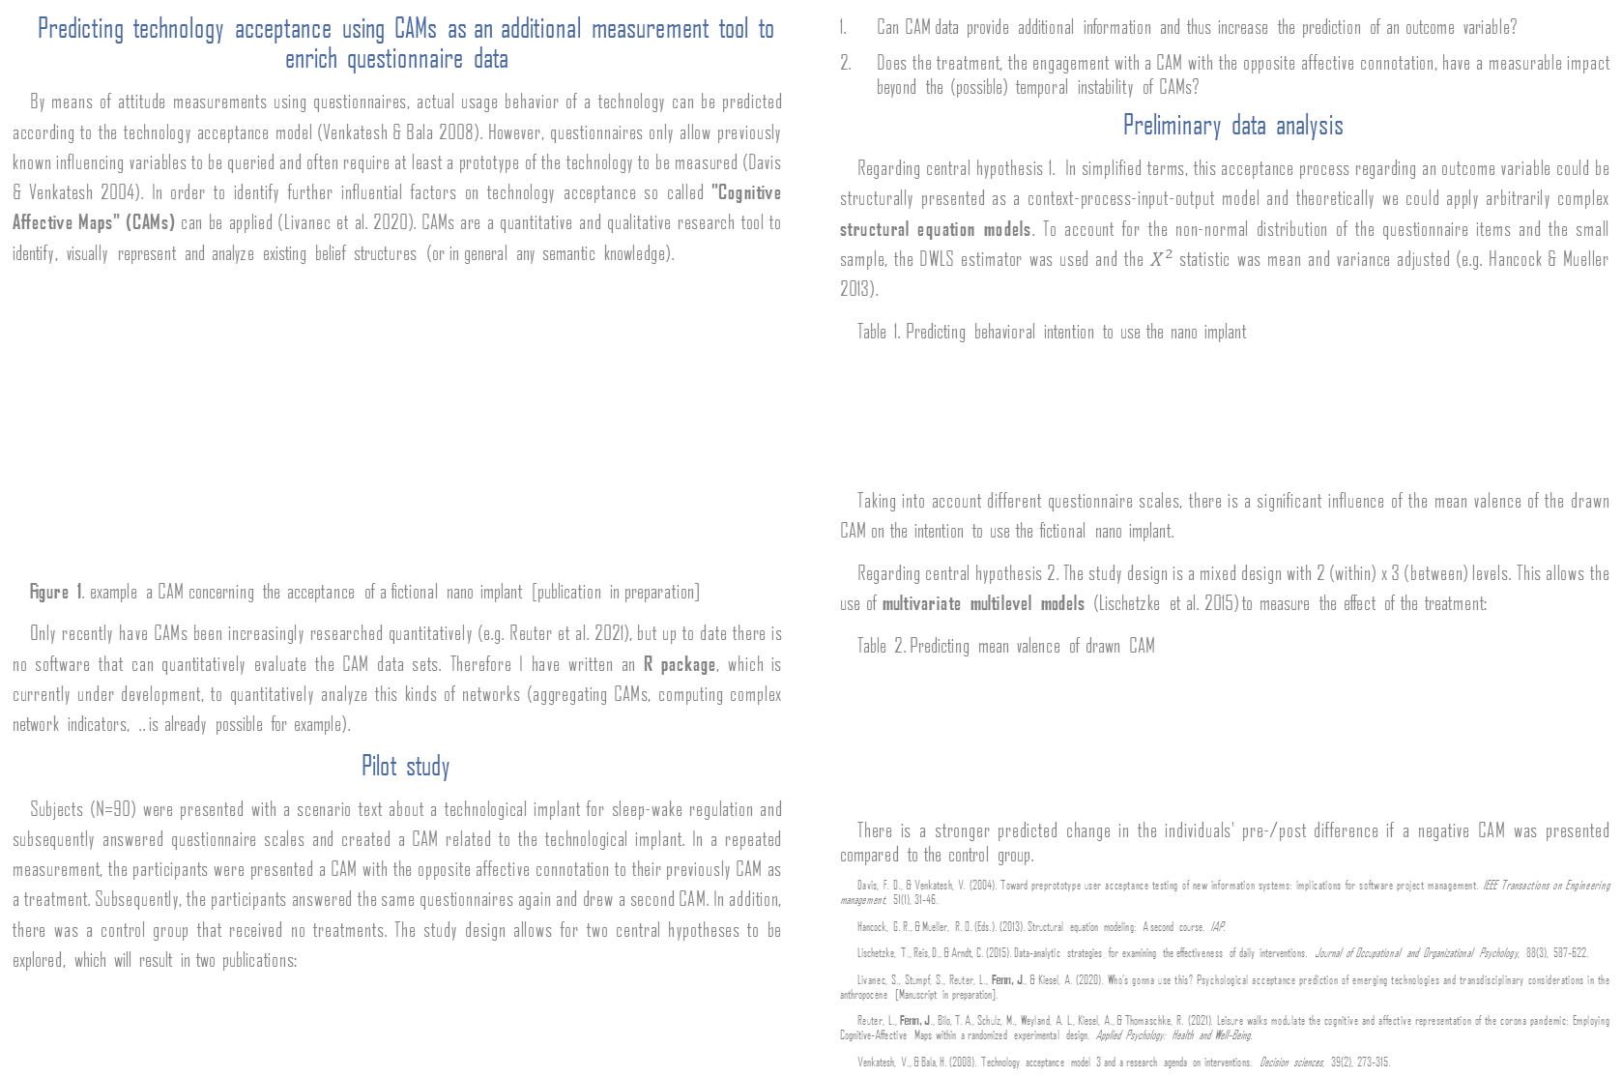
Predicting technology acceptance using CAMs as an additional measurement tool to enrich questionnaire data
By means of attitude measurements using questionnaires, actual usage behavior of a technology can be predicted according to the technology acceptance model (Venkatesh & Bala 2008). However, questionnaires only allow previously known influencing variables to be queried and often require at least a prototype of the technology to be measured (Davis & Venkatesh 2004). In order to identify further influential factors on technology acceptance so called "Cognitive Affective Maps" (CAMs) can be applied (Livanec et al. 2020). CAMs are a quantitative and qualitative research tool to identify, visually represent and analyze existing belief structures (or in general any semantic knowledge).
Figure 1. example a CAM concerning the acceptance of a fictional nano implant [publication in preparation]
Only recently have CAMs been increasingly researched quantitatively (e.g. Reuter et al. 2021), but up to date there is no software that can quantitatively evaluate the CAM data sets. Therefore I have written an R package, which is currently under development, to quantitatively analyze this kinds of networks (aggregating CAMs, computing complex network indicators, .. is already possible for example).
Pilot study
Subjects (N=90) were presented with a scenario text about a technological implant for sleep-wake regulation and subsequently answered questionnaire scales and created a CAM related to the technological implant. In a repeated measurement, the participants were presented a CAM with the opposite affective connotation to their previously CAM as a treatment. Subsequently, the participants answered the same questionnaires again and drew a second CAM. In addition, there was a control group that received no treatments. The study design allows for two central hypotheses to be explored, which will result in two publications:
Can CAM data provide additional information and thus increase the prediction of an outcome variable?
Does the treatment, the engagement with a CAM with the opposite affective connotation, have a measurable impact beyond the (possible) temporal instability of CAMs?
Preliminary data analysis
Regarding central hypothesis 1. In simplified terms, this acceptance process regarding an outcome variable could be structurally presented as a context-process-input-output model and theoretically we could apply arbitrarily complex structural equation models. To account for the non-normal distribution of the questionnaire items and the small sample, the DWLS estimator was used and the $X^{2}$ statistic was mean and variance adjusted (e.g. Hancock & Mueller 2013).
Table 1. Predicting behavioral intention to use the nano implant
Taking into account different questionnaire scales, there is a significant influence of the mean valence of the drawn CAM on the intention to use the fictional nano implant.
Regarding central hypothesis 2. The study design is a mixed design with 2 (within) x 3 (between) levels. This allows the use of multivariate multilevel models (Lischetzke et al. 2015) to measure the effect of the treatment:
Table 2. Predicting mean valence of drawn CAM
There is a stronger predicted change in the individuals' pre-/post difference if a negative CAM was presented compared to the control group.
Davis, F. D., & Venkatesh, V. (2004). Toward preprototype user acceptance testing of new information systems: implications for software project management. IEEE Transactions on Engineering management, 51(1), 31-46.
Hancock, G. R., & Mueller, R. O. (Eds.). (2013). Structural equation modeling: A second course. IAP.
Lischetzke, T., Reis, D., & Arndt, C. (2015). Data‐analytic strategies for examining the effectiveness of daily interventions. Journal of Occupational and Organizational Psychology, 88(3), 587-622.
Livanec, S., Stumpf, S., Reuter, L., Fenn, J., & Kiesel, A. (2020). Who’s gonna use this? Psychological acceptance prediction of emerging technologies and transdisciplinary considerations in the anthropocene [Manuscript in preparation].
Reuter, L., Fenn, J., Bilo, T. A., Schulz, M., Weyland, A. L., Kiesel, A., & Thomaschke, R. (2021). Leisure walks modulate the cognitive and affective representation of the corona pandemic: Employing Cognitive‐Affective Maps within a randomized experimental design. Applied Psychology: Health and Well‐Being.
Venkatesh, V., & Bala, H. (2008). Technology acceptance model 3 and a research agenda on interventions. Decision sciences, 39(2), 273-315.
predictors | est (std.) | se | pvalue
PANAS scale negative | -.218 | .054 | < .01
PANAS scale positive | .543 | .064 | < .01
Perceived usefulness of the nano implant | .217 | .059 | < .01
mean valence of drawn CAM | .455 | .082 | < .01
predictors | est (se) | predictors | est (se)
Constant | -0.120 (0.079) | factor scores PANAS neg. | -0.122 (0.059)**
post | 0.149 (0.091) | post x neg. CAM presented | -0.757 (0.162)***
neg. CAM presented | 0.515 (0.142)*** | post x pos. CAM presented | 0.564 (0.169)***
pos. CAM presented | -0.464 (0.145)*** | post x factor scores PANAS neg. | -0.131 (0.072)*
Exploring cognitive affective maps as a new mode of data collection – a future complementary survey research method? Julius Fenn, University of Freiburg, 4st SMiP cohort, Supervisors: Andrea Kiesel, Thorsten Meiser, Tanja Lischetzke
Notes:
2-column design for graphic-heavy posters
Adjust font sizes to fit Title & Authors in one line each (but no smaller than 12pt!)
IMPORTANT: This template uses the font "Lora" for titles (it is also used in the SMiP logo). You can download (and then install) the font from
https://fonts.google.com/specimen/Lora
(it is licensed under the SIL Open Font License (cf. http://scripts.sil.org/OFL) which means you can use it freely (except for commercial purposes))

